Slide 1
Hackathon_21
DIZME This is me

Slide 2
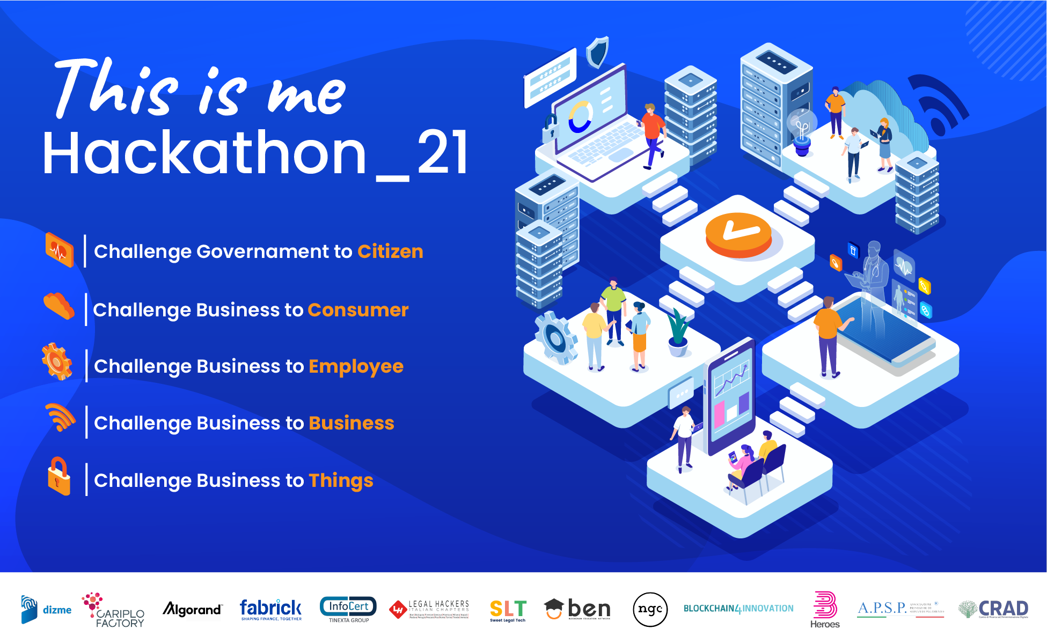
Hackathon_21

Slide 3

Wordpress DizmePlugin
Araneum Group srl
DD/MM/YYYY h xx.xx

Slide 4
Agenda presentazione Giuria
CONTENT
Use case Description
How we built it
Market approach and follow up
Who built it
Hackathon_21

Slide 5
1
Use case description
Use case and motivation

Slide 6
Use case description
Plastic Badges dematerialization for interacting with the company
The corporate site of Araneum Group srl, including intranet area, is based on WordPress, which according to recent statistics powers 39% of all Internet Sites.
We planned to build a WordPress Plugin for signing up and authentication, which enables to issue the Employee credentials and eventually to verify them for authentication and authorization, enabling access to the services of the site using Verifiable Credentials.
The plugin enables 2-click configuration in order to start using the Dizme Wallet and Self Sovereign Identity
The password repository on the server is removed, thus reducing risks in cases of hacking of the server
The verifiable credentials can be used in the future to have access to the workplace
DIZME This is me

Slide 7
2
How we built it
Technical and Demo/Video

Slide 8
Demo - Video
WordPress DizmePlugin
Architecture:
Demo Video of the solution : xxxxxxxx
DIZME This is me

Slide 9
3
Market approach and follow up
Go To Market – Business plan

Slide 10
Business model
WordPress DizmePlugin
The plugin is a fully-working POC
With some investments and further work, it can:
become an asset of DizmeID Foundation
operated by a reseller, who takes care of installation and configuration for their clients
released as open source for the entire Dizme ecosystem
DIZME This is me

Slide 11
4
Il Team
Araneum Group srl

Slide 12
The team
Araneum Group srl
Dott. Fabio Lecca – CTO Araneum Group srl
Graduated from University "La Sapienza" of Rome
More than 20 years in development and project management, expert in Blockchain Technologies
(certifications: Linux Foundation LFS170x, LFS171x, LFS172x, LFS173x in progress)
Ing. Paolo Mazzitti – Tesista Araneum Group srl
Graduated from University "Roma Tre" of Rome
(certifications: Linux Foundation LFS170x, LFS172x, LFS173x in progress)
DIZME This is me

Slide 13
Thank you

